Slide 1
Research Integrity
Doing Political Research

Slide 2
Problems and Solutions
Fraud
Replication crises
Publication bias and the file drawer problem
Cherry-picking and p-hacking
Peer review
Data transparency and replication
Pre-registration
Null results reporting

Slide 3


Fraud
High-profile scandals get a lot of attention eg Michael LaCour, Alice Goffman
Causes
Competitive nature of academia
Weak safeguards?
But such cases are thankfully rare
More problematic are biases caused by structure of academic research involving researchers working in good faith

Slide 4
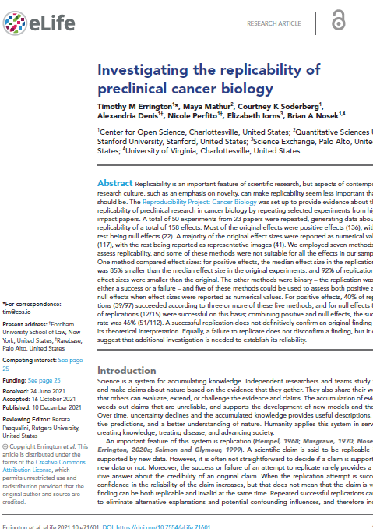
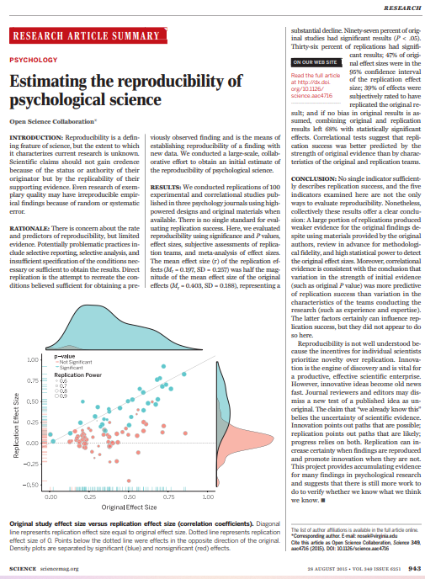
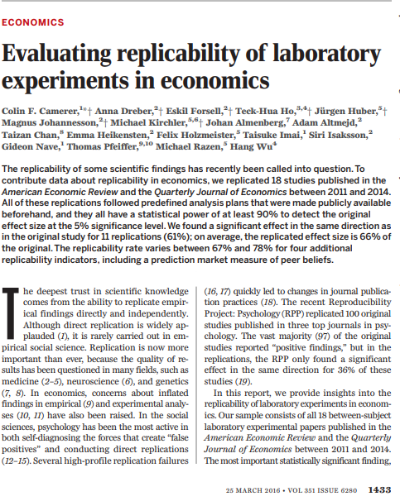
Replication Crises
Psychology: only 39% of findings in top journals could be replicated (Open Science Collaboration 2015)
Economics: 61% of experiments could be replicated (Camerer et al 2016)
Medicine: 46% of preclinical cancer experiments could be replicated (Errington et al 2021)
Politics?

Slide 5

Publication Bias and the File Drawer Problem
10 researchers investigate the effect of religious diversity on conflict
2 find that religious diversity drives conflict. These are published.
8 find no relationship. These are not published.
Our knowledge is therefore skewed.
What causes publication bias?
Journal editors, book publishers and reviewers are interested in new, exciting findings
Researchers lose interest if they don’t find interesting results

Slide 6
Cherry-picking and p-hacking
We investigate the effect of religious diversity on conflict and hypothesise a positive relationship between the two
We find no evidence that religious diversity affects most kinds of conflict, but it does increase riots
We publish just the finding on riots and claim that religious diversity increases conflict
p-hacking refers to p-values, which tell us whether a finding is statistically significant
The traditional cut-off if 0.05, and more findings than expected fall just under 0.05
This implies either/both publication bias or deliberate manipulation of statistical models to achieve publishable findings

Slide 7
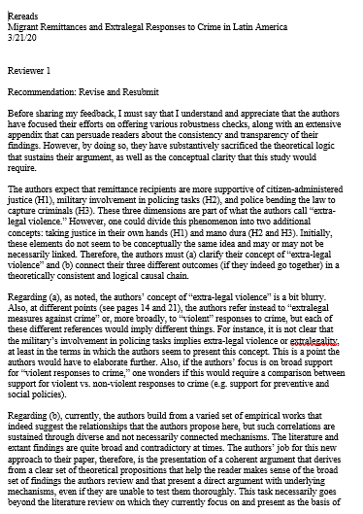
Peer Review
Articles and books are reviewed by experts before being published
Origins in the 18th century but became commonplace from mid-20th century
Usually double blind
Possible outcomes of peer review: publish, reject, revise and resubmit
Problems
Bad or slow reviewers
Reviewers are not neutral
Reviewers do not see underlying data
Double blind reviewing is difficult in the Internet era

Slide 8

Pre-registration
Publishing your theory and research design before conducting the research so that you cannot cherry-pick your findings
‘Registered reports’: journals commit to publishing an article without seeing the results
Problems:
No common standard for pre-analysis plans (yet)
What about exploratory, theory-generating research?
Works more easily for quantitative than qualitative research
Genuinely interesting findings that were not initially considered might get ignored

Slide 9
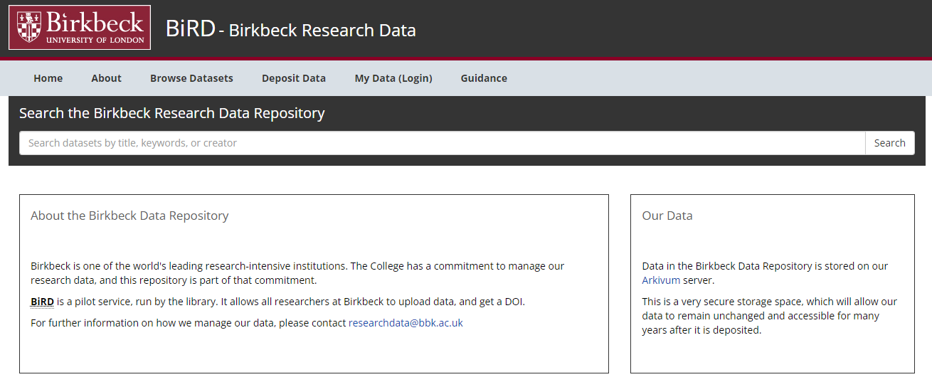
Data Transparency and Replication
APSA embraced a policy on ‘Data Access and Research Transparency’ in 2015
The principle is that all data used in research should be made accessible so that it can be examined and replicated
Many journals now require this, and some independently replicate analyses before publication
Problems
Some data is proprietary or has been obtained at great cost to the researcher
Clashes with ethical principles about anonymity of research participants
Quantitative datasets can easily be shared, but what about qualitative field/archive notes?

Slide 10
Null Results Reporting
Combatting the file drawer problem by reporting null results
Some journals have started publishing null results reports
Alrababa’h et al suggest doing this informally
Problems
What is the incentive for researchers to write up null results?
Is the null result due to problems with the research design?
A null result is much more obvious in quantitative than qualitative research

Slide 11
Conclusion
There are many threats to the integrity of political research
Most are caused by the structures and institutions of research and publication, rather than malfeasance
In recent years, new strategies have been developed to tackle some of the problems
But these bring a new set of challenges
Many strategies work better for quantitative and positivist research, but can be adapted for qualitative and non-positivist work
Reflecting on research integrity is very important for both researchers and those who read and use research

